Slide 1
WATER POLLUTION
IN PAKISTAN
presented by Allahdad

Slide 2
.
“Thousands have lived without love, not one without water ” W.H Auden

Slide 3



THE THINGS WE ARE GOING TO DISCUSS
.
IS WATER POLLUTION
WATER POLLUTION
EFFECT ?
CAN WE ELIMINATE IT?

Slide 4
WHAT IS WATER POLLUTION?
Water pollution is the contamination of water sources by substances that make the water unusable for drinking, cooking, cleaning, swimming, and other activities.

Slide 5
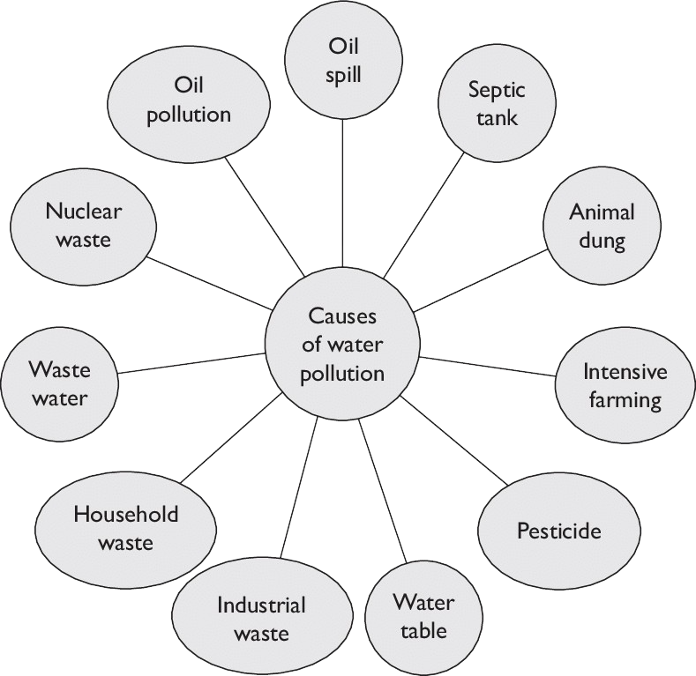
C
A
U
S
E
S
O
F
W
A
T
E
R
P
O
L
L
U
T
I
O
N

Slide 6

OUR EARTH COMPRISES ABOUT 70% OF WATER FROM 70% , HUMANS AND ANIMAL CONSUME ROUGHLY 1% OF WATER

Slide 7

BUT WHERE THE OTHER
69 PERCENT GO

Slide 8
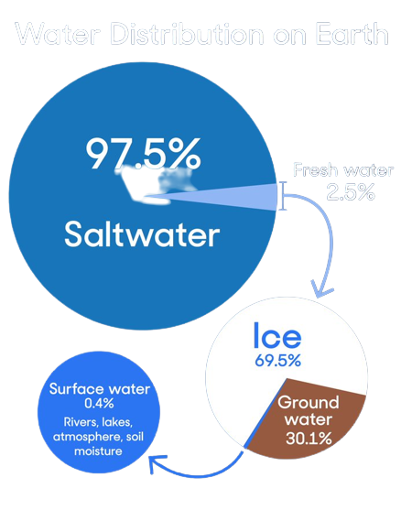
TABLE SHOWS WATER OF EARTH
WATER | ON | EARTH
SALT WATER | 97.5 | %
AVAILABLE FRESH WATER | 1 | %
POLAR ICECAPS | 1.5 | %

Slide 9
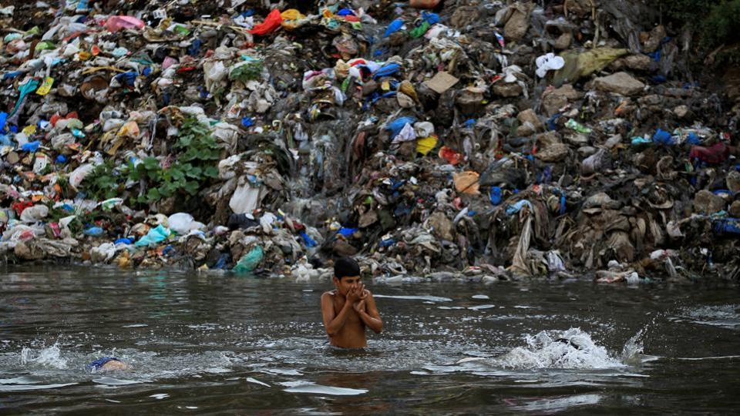
Years of mismanagement and pollution have left Pakistan the third most water-stressed country in the world.

Slide 10
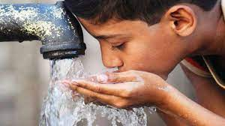
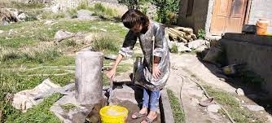
For most Pakistanis, just being able to turn on the tap and get clean water is a luxury they can only dream about.
‘
‘

Slide 11
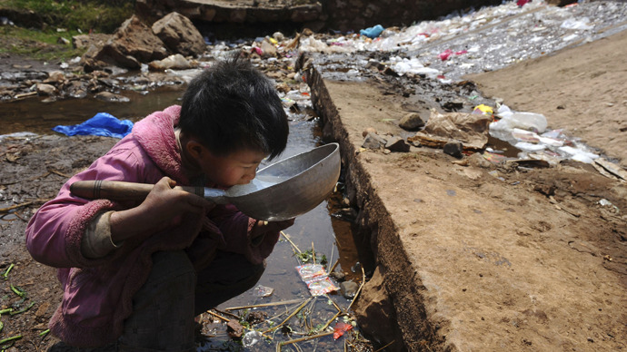
Estimated Water Pollution Cause 40% Of Death All Over Pakistan

Slide 12
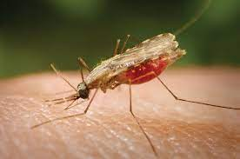
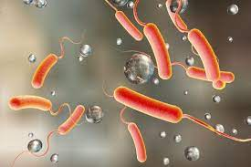
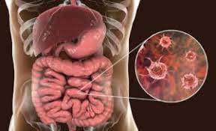
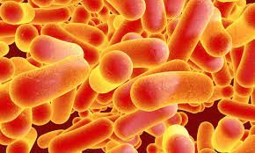
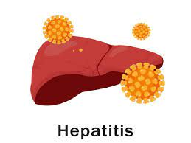
DISEASES CAUSE BY POLLUTED WATER
Malaria
Chlorea
Typhoid
Dysentery
Hepatitis

Slide 13

BUT WHERE THE ALL PURE WATER GO??

Slide 14
93 %
OF THE COUNTRY WATER IS USED FOR AGRICULTURE .
THIS LEAVES VERY LITTLE WATER FOR DOMESTIC USE
5% IS FOR INDUSTRY
AND
2% IS FOR OTHER PURPOSES

Slide 15
PAKISTAN AS A AGRICULTURAL COUNTRY

Slide 16
99 % OF THE PAKISTANI’S FARMERS HAVE NO IDEA ABOUT WATER MANAGEMENT DURING FARMING
On average, farms around the world account for 70% of all water that is consumed annually. Of that 70% used by farmers,
40% is lost to the environment due to poor irrigation systems, evaporation, and overall poor water

Slide 17

.

Slide 18
IS WATER POLLUTION A BIG ISSUE

Slide 19
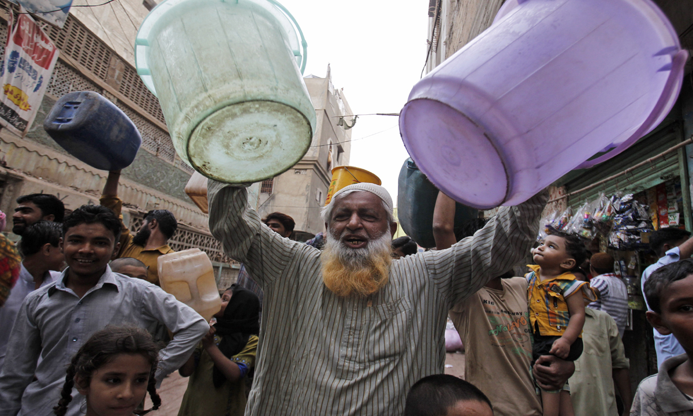
We ARE A POOR COUNTRY !!
.
WE ARE RUNNING OUT OF RESOURCES !!

Slide 20
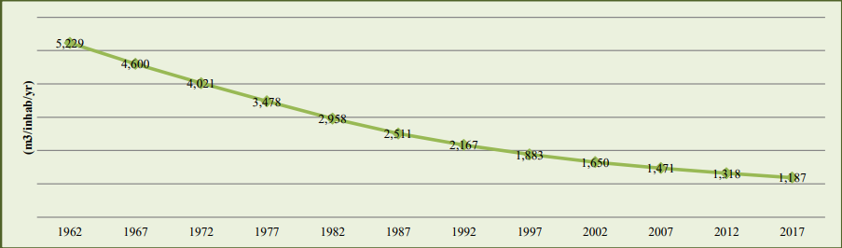
THIS IS HOW WE ARE RUNNING OUT OF WATER RESOURCES !!

Slide 21
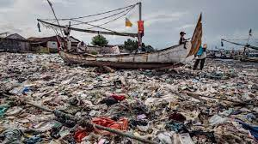
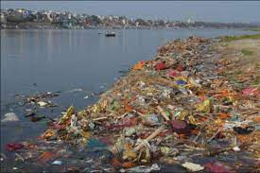
PLASTIC AS A BIG ENEMY OF WATER

Slide 22

Single Wrapper Of Plastic Take Millions Of Year To Just Dissolve In Water THE ONLY WAY TO STOP IT IS NOT USING IT

Slide 23
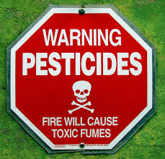
Proper Disposal of Pesticides and Containers
Proper Pesticide Storage

Slide 24
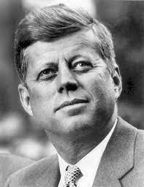
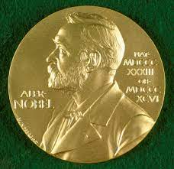
‘’Anyone who can solve the problems of water will be worthy of two noble prizes – one for peace and one for science” John F Kennedy[1]

